Slide 1
Comparing Two Means
Chapter 9

Slide 2
Experiments
Simple experiments
One IV that’s categorical (two levels!)
One DV that’s interval/ratio/continuous
For example, manipulation of the independent variable involves having an experimental condition and a control.
This situation can be analysed with a t-test
Notes:
E.g., Is the movie Scream 2 scarier than the original Scream? We could measure heart rates (which indicate anxiety) during both films and compare them.

Slide 3
The t-test
In the book, this is related to regression/correlation.
We will cover regression later, as it is traditionally used with more continuous type predictors (IVs).
However, one thing to know is that t-tests and ANOVAs are all special types of regression with categorical predictors.
Why not do it all regression in SPSS?
The output is much easier using t-tests/ANOVAs.

Slide 4
Experiments
Median splits are bad.
You separate the people who are close together and lump them with people who are not really like them.
Effect sizes get smaller.
Power/Type 2 problems.

Slide 5
Experiments
Reminder: when you manipulate the levels of the IV, you are working with experimental research. If you just are examining two naturally occurring categories, then quasi-experimental/correlational.

Slide 6
Experiments
Between subjects / Independent designs
When the people are in separate levels and only do one of the manipulations
Repeated measures / within subjects / dependent designs
When the people get all of the levels

Slide 7
The t-test
Independent t-test
Compares two means based on independent data
E.g., data from different groups of people
Dependent t-test
Compares two means based on related data.
E.g., Data from the same people measured at different times.
Data from ‘matched’ samples.

Slide 8

Rationale to Experiments
Group 1
Group 2
Lecturing Skills
Variance created by our manipulation
Removal of brain (systematic variance)
Variance created by unknown factors
E.g. Differences in ability (unsystematic variance)

Slide 9
Independent t-test Example
Are invisible people mischievous?
24 Participants
Manipulation
Placed participants in an enclosed community riddled with hidden cameras.
12 participants were given an invisibility cloak.
12 participants were not given an invisibility cloak.
Outcome
measured how many mischievous acts participants performed in a week.

Slide 10
Rational for the t-test
Let’s use the invisibility cloak data.
Two groups (levels!):
Cloak versus no cloak.
What would our null hypothesis be?
What would our research hypothesis be?

Slide 11
Rational for the t-test
Two samples of data are collected and the sample means calculated. These means might differ by either a little or a lot.
Let’s calculate the two means.
Review of split file.

Slide 12
Rational for the t-test
If the samples come from the same population, then we expect their means to be roughly equal. Although it is possible for their means to differ by chance alone, we would expect large differences between sample means to occur very infrequently.

Slide 13
Rational for the t-test
We compare the difference between the sample means that we collected to the difference between the sample means that we would expect to obtain if there were no effect (i.e. if the null hypothesis were true).
So Mean Cloak versus Mean No Cloak
If the null is true, what does that imply for the means?

Slide 14
Rational for the t-test
We use the standard error as a gauge of the variability between sample means. If the difference between the samples we have collected is larger than what we would expect based on the standard error then we can assume one of two:
Draw histograms here (use a stacked histogram).

Slide 15
Rational for the t-test
There is no effect and sample means in our population fluctuate a lot and we have, by chance, collected two samples that are atypical of the population from which they came.
The two samples come from different populations but are typical of their respective parent population. In this scenario, the difference between samples represents a genuine difference between the samples (and so the null hypothesis is incorrect).

Slide 16
Rational for the t-test
As the observed difference between the sample means gets larger, the more confident we become that the second explanation is correct (i.e. that the null hypothesis should be rejected).
If the null hypothesis is incorrect, then we gain confidence that the two sample means differ because of the different experimental manipulation imposed on each sample.

Slide 17
Rationale to the t-test
t | = | observed difference between sample means | − | expected difference between population means (if null hypothesis is true)
 |  | estimate of the standard error of the difference between two sample means

Slide 18
The Independent t-test

Slide 19
The Independent t-test
Let’s try this with the descriptives we collected earlier.
What are all these parts in the things we’ve talked about?
DF
Standard deviation
Standard error

Slide 20
The Independent t-test
Ok, I’ve got t, now what?
The t table.
Why should I care? SPSS gives me p?
Many Type 1 corrections require you to use t or q tables.

Slide 21
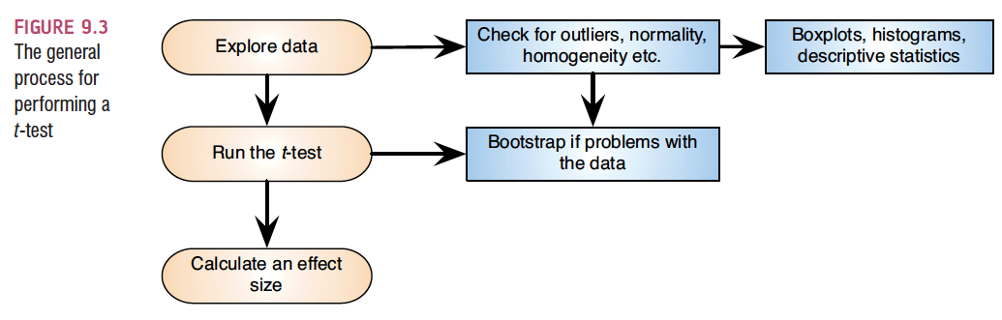
Independent t-test using SPSS

Slide 22
Independent t-test using SPSS
All that data screening still applies.
With this data, univariate = multivariate because we only have one continuous measure to screen.
I usually always screen multivariate (until problems arise) because they are equal with one variable (so it’s one set of rules to remember).

Slide 23
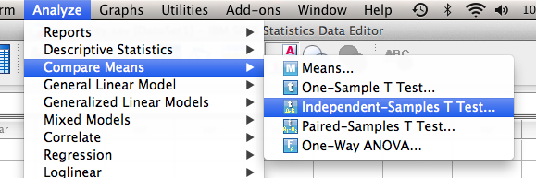
Independent t-test using SPSS
Analyze >
Compare means >
Independent samples t-test

Slide 24
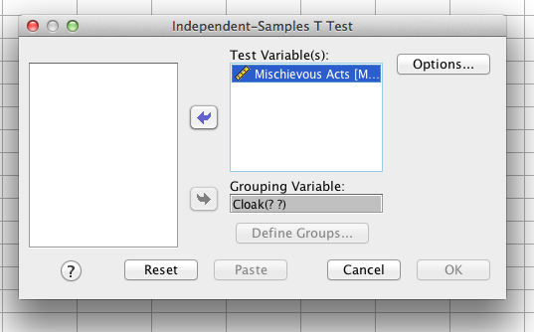
Independent t-test using SPSS
IV (categorical) goes in grouping variable.
DV (continuous) goes in test variables.

Slide 25
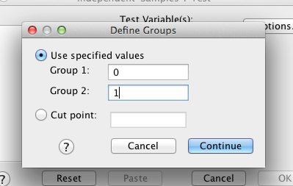
Independent t-test using SPSS
What to do about those ? ? Marks.
Hit define groups > enter your numbers you had for the value labels.
(This is why you can’t just use text).

Slide 26
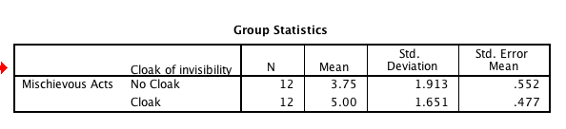
Independent t-test using SPSS
Hit ok, get some output.
First box = means.

Slide 27
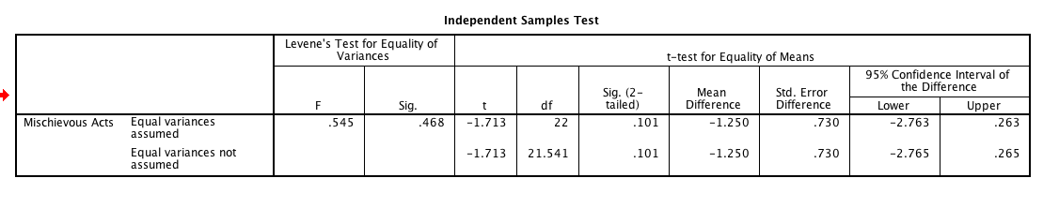
Independent t-test using SPSS
Second box = t-test.

Slide 28

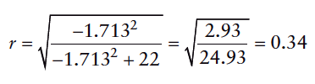

Calculating the Effect Size

Slide 29
Reporting the independent t-test
On average, participants given a cloak of invisibility engaged in more acts of mischief (M = 5.00, SE = 0.48), than those not given a cloak (M = 3.75, SE = 0.55). This difference, −1.25, BCa 95% CI [−2.61, 0.04], was not significant t(22) = −1.71, p = .10; however, it did represent a medium-sized effect d = .65.
(two decimals!).

Slide 30
Dependent t-test Example
Are invisible people mischievous?
24 Participants
Manipulation
Placed participants in an enclosed community riddled with hidden cameras.
For first week participants normal behaviour was observed.
For the second week, participants were given an invisibility cloak.
Outcome
measured how many mischievous acts participants performed in week 1 and week 2.

Slide 31
Dependent t-test
The logic of this test is roughly the same, but you have to consider the matched nature of dependent results.
So now we are going to use the standard error of the differences rather than standard error.
Compute difference scores in SPSS (practice with tranforms).

Slide 32
The Dependent t-test

Slide 33
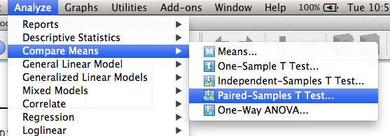
Dependent t-test in SPSS
Analyze >
Compare means >
Paired samples t-test

Slide 34
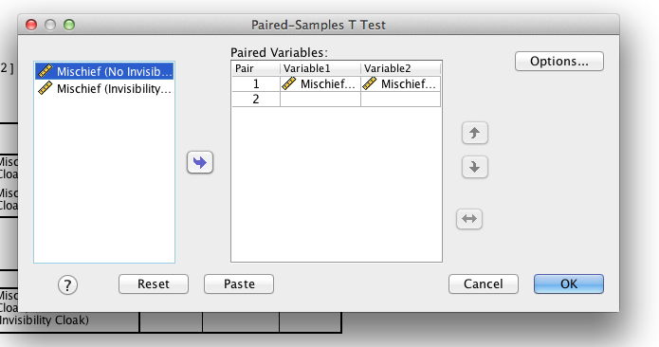
Dependent t-test in SPSS
Move both over to the right, hit ok.

Slide 35
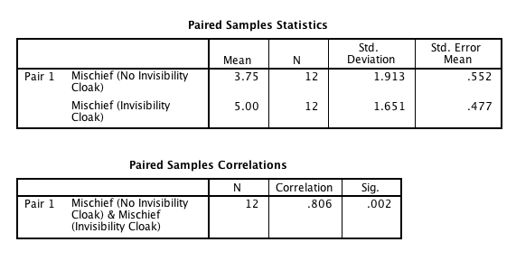
Dependent t-test in SPSS

Slide 36
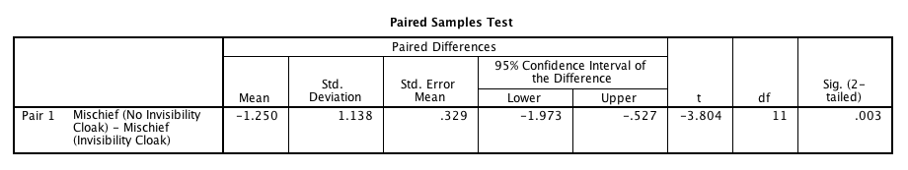
Dependent t-test in SPSS

Slide 37
Effect Size
Please note if you use r, then you cannot use the paired samples correlation … we are correcting for the matched nature of the experiment.

Slide 38


Calculating an Effect Size

Slide 39
Reporting the paired-samples t-test
On average, participants given a cloak of invisibility engaged in more acts of mischief (M = 5.00, SE = 0.48), than those not given a cloak (M = 3.75, SE = 0.55). This difference, −1.25, 95% CI [−1.67, −0.83], was significant t(11) = −3.80, p = .003 and represented a medium-sized effect d = .65.

Slide 40
Back to graphs
Create these using bar charts!
How to deal with the stupid error bar problem.

Slide 41
Error Bar Solution
Step 1) Calculate the mean for each participant (i.e. average cloak and no cloak).
Transform > compute
MEAN(variables)
Hit ok.

Slide 42
Error Bar Solution
Step 2) Calculate the grand mean.
Analyze > descriptives > frequencies.
Move over the new mean you just calculated.

Slide 43
Error Bar Solution
Step 3) Calculate the adjustment (i.e. we are dealing with the repeated nature business).
Transform > compute.
Your adjusted variable = Grand mean – Mean of participants.

Slide 44
Error Bar Solution
Step 4) Create new adjusted original scores.
Transform > compute.
Cloak_adj = cloak + adjustment (from last step).
Nocloak_adj = nocloak + adjustment (from last step).

Slide 45
Error Bar Solution
Now graph those!

Slide 46
Assumptions of the t-test
Both the independent t-test and the dependent t-test are parametric tests based on the normal distribution. Therefore, they assume:
The sampling distribution is normally distributed. In the dependent t­-test this means that the sampling distribution of the differences between scores should be normal, not the scores themselves.
Data are measured at least at the interval level.

Slide 47
Assumptions of the t-test
The independent t-test, because it is used to test different groups of people, also assumes:
Variances in these populations are roughly equal (homogeneity of variance).
Scores in different treatment conditions are independent (because they come from different people).

Slide 48
Assumptions of the t-test
In plain old English,
Independence
(accuracy, missing, outliers are dealt with).
Normality
Linearity
Homogeneity/Homoscedasticity
(basically not multicollinearity because there’s only one DV).

Slide 49
When Assumptions are Broken
Dependent t-test
Mann-Whitney Test
Wilcoxon rank-sum test
Independent t-test
Wilcoxon Signed-Rank Test
Robust Tests:
Bootstrapping
Trimmed means

